Slide 1
Local Officers Online Orientation
The class is scheduled to begin at 10am
If you encounter technical issues with the audio or internet connection,
please call GoToTraining Support:
855-352-9002.
WE WILL BEGIN MOMENTARILY.
WE WANT TO GIVE A FEW EXTRA MOMENTS FOR PEOPLE WHO MAY BE HAVING TECHNICAL DIFFICULTIES TO JOIN.
THANK YOU
Notes:
DO: Organizer should open the session and show their screen with this slide at least 30 minutes before the start of the class.
DO: If there are a few people still missing at the start time, CLICK to show extended messaging regarding giving people a few more moments to join. Plan to give people a 3-5 minute grace period.
(OPTIONAL) SAY: Good Morning, we will give a few more people the opportunity to join us who may be having technical difficulties. Thank you for your patience, we will begin shortly.

Slide 2
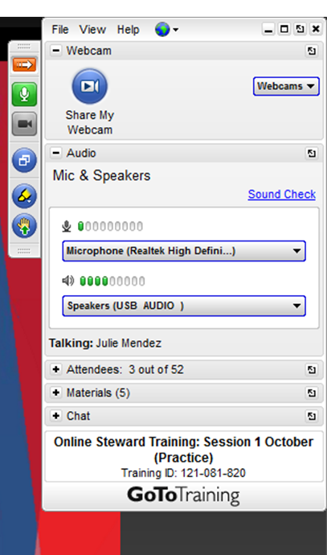
GoToTraining Tools
CONTROL PANEL KEY
MUTE/UNMUTE
RAISE YOUR HAND
COURSE PARTICIPANTS
COURSE MATERIALS
CHAT
Notes:
SAY: Welcome to AFGE’s Online New Leaders class. My name is __and I want to introduce__. We will be your instructors for this New Leaders Orientation Class; which is designed to be a short introduction for new leaders in order to gain foundational knowledge of what it means to be a leader at AFGE, the resources you have, and how to represent our members. Since this is just an orientation, this particular class will not go deep into certain topics, but after this class, you can continue learning in different ways in which we will further discuss later.
Thank you again for participating and we are using a new technology and delivery format to provide this important training. We look forward to hearing your feedback on this program. Please use the CHAT feature or email us to let us know if you have questions or if you encounter problems with the course.
(Discuss each of the GoToTraining tools as you clock to highlight the tool). DO: Have people try out the raise your hand feature, the chat feature, and open up a document from the materials tab.
¥ CHAT
¥ CONTROL PANEL KEY
¥ MUTE/UNMUTE
¥ RAISE HAND (discuss use in class discussions, activities)
¥ MATERIALS

Slide 3
Topics on Today’s Agenda
AFGE Structure and Governance
Big Enough to Win
AFGE Constitution
Your role as an AFGE Leader
Legal Framework/Relevant Laws
Fiduciary Responsibilities as a Leader
Hatch Act
Resources
Notes:
DO: READ SLIDE TO REVIEW WHAT TOPICS WILL BE COVERED IN TODAY’S SESSION

Slide 4
Class Norms
Participate in class activities and discussion.
Raise your virtual hand to be recognized before speaking.
If you are on the phone line, please place the phone on Mute when not speaking
Notes:
DO: READ SLIDE: Emphasize that though this is a virtual class, participation is equally as important as it would be in a face to face class. This tool is designed for participation like the raise your hand feature and the chat feature.

Slide 5
Course Objectives:
Review and discuss the legal frameworks that guides the work you do as leaders of the union.
Gain a better understanding of your roles and responsibilities as an AFGE Local Union leader.
Notes:
SAY: This course will introduce you to the many responsibilities you hold as a union leader at AFGE and will help you to identify key resources you will need to effectively serve your members. This course is an orientation level course, and is not intended to dive too deep into any one particular area, but to provide new leaders with a basic overview of what their role entails, and what resources they have at hand as they begin their journey. Here are the course objectives DO: (READ SLIDE)

Slide 6
INTRODUCTIONS
Leadership Essentials:
Building Good Relationships
Maintaining high standards of honesty and integrity
Treat everyone with respect and dignity
Recognize needs of members and be available
Communicate and educate
Build solidarity and pride in the union
Maintain a positive environment
Be a good listener
Insist on excellence
WHAT IS YOUR NAME?
WHAT LOCAL ARE YOU FROM? WHERE IS IT? (State/District)
WHY DID YOU BECOME A LEADER IN THE UNION?
HOW LONG HAVE YOU SERVED AS A LEADER AT AFGE?
Notes:
FYI***(THIS SLIDE HAS ANIMATIONS)***
DO: Invite participants to raise their hands or use the chat feature to introduce themselves using the questions outlined on the slide. (If it is a small class—encourage everyone to raise their hand to speak. Larger classes should have the option to either speak or use the chat feature).
DO: (ANIMATION HERE) Once everyone has had a chance to introduce themselves, CLICK to show bubble that discusses “Leadership Essentials: Building Good Relationships” and read the content.

Slide 7
What Must an AFGE Leader know?
RAISE YOUR HAND TO RESPOND, OR USE THE CHAT BOX
AFGE's Field Services and Education Department
Notes:
ASK: Thinking about the role of the leader, what are things that local leader must know?
DO: allow people to write in responses in chat box or to raise their hand to answer.

Slide 8
Federal and State Laws
AFGE National Constitution
Local Constitution and By Laws
AFGE Structure and Governance
Basic Leadership Skills
Communication
Running Meetings
Strategic Planning
Time Management/Delegating
Example of things AFGE Leaders should know
Notes:
DO: Read the slide and summarize what has already been stated in the brainstorm from the previous slide.

Slide 9
What Must an AFGE Leader do?
RAISE YOUR HAND TO RESPOND, OR USE THE CHAT BOX
AFGE's Field Services and Education Department
Notes:
ASK: Thinking about the role of the leader, what are things that local leader do?
DO: allow people to write in responses in chat box and reiterate what they say as well as add to what was already said.

Slide 10
Notes:
SAY: In thinking about what a Local Leader must do, one of the main things is to build a strong local. That could look like many different things depending on position and perspective, but overall a good place to start is building a strong local union leadership team. Take a look at this chart which shows some things to consider regarding building a strong leadership team.
DO: Read the content in the boxes

Slide 11
Local Leaders should make AFGE’s mission thrive:
“To build a large, powerful, effective union for workers in government service”
Notes:
SAY: Also when considering what an AFGE leader must do is what any good leader must do in any organization and that is to align themselves with and push forward the mission. As leaders of AFGE one of the things your should do is push the mission of AFGE forward, which is to build a large powerful effective union for workers in government service. The words large, powerful and effective are directly connected to AFGE’s vision Big Enough To Win (BETW). How many of you have heard about BETW? DO: (ask participants to raise their hands if they have)
SAY: BETW has been AFGE’s strategic vision since 2013 after 700 local leaders gathered in Orlando to discuss the best way to move forward to prepare to fight the battles that they knew we would face. Needless to say, we are currently facing some of those battles that was foreseen back in 2013 and now after 5 years of growing consistently in numbers, largely due to strategic direction under BETW… local leaders have started to think through how this union equips itself to “Fight to Win” We have most certainly succeeded at becoming large, but need to work on being more powerful and more effective. And becoming more powerful and more effective starts at the Local level.

Slide 12
….Building Strong Locals
This is the primary goal of the Local Union Officer
The strength of AFGE is based on the strength of the Locals
Building “effective” Locals to be Big Enough to Win!
Notes:
SAY: That is why we must, all leaders at every level of this union, prioritize building strong locals. Every Local Leader should have a desire to see and build stronger Locals (which in turn increases our ability as a union to better service our members—which is always the bottom line of the work that we do). Looking at the big picture, the primary goal as an AFGE leader should be to build stronger Locals. AFGE the union, is only as strong as its Locals and ultimately this is truly how we as a union become big enough to win. So, the question is, what does that mean exactly? What do you think it means to build a strong Local?
DO: (Solicit comments from the participants).

Slide 13
What are Effective Locals?
Effective locals have ownership of the Union, have the capability, infrastructure and engagement to support and mobilize the membership.
They are not dependent upon the employer, they are not dependent upon representatives- they empowered, and they are big enough to win.
Notes:
SAY: Strong locals are effective
DO: Read the slide

Slide 14
Key Areas of Big Enough to Win
Organizing and Workplace Representation
Legislative & Political Mobilization
Strengthening the Local
Education
Communications
Notes:
SAY: For those of you who have heard of BETW this should look familiar to you. When it came to breaking down what it would take for Locals to move toward being more strong and effective there were five categories that were named as ideal priorities. And though there are additions to this strategy worth discussing, which we will address in the next slide, these same categories should still be what locals consider as they continue to work on building their strength. So, take a look at these categories. Based on your own experience, or what you know from observation, or your best educated guess, which one of these categories are the most time consuming, or tends to become one of the, if not the only, priority for many locals….
DO: LAUNCH POLL and give participants a few moments to respond
SAY: Its usually this first one, Organizing and Workplace Representation. In fact, when it comes to how many people view unions, this is what they think of what we do. These strategic directives is a needed reminder that Locals are more diverse than solely representation and the strategy every Local implement should reflect that. So let’s briefly review these categories here:
Organizing and Workplace Representation: Setting specific goals regarding increasing membership each year with a plan for year-round organizing, and making sure the we do what we have been doing well in the areas of representation. There is an organizing department that has guidance on how to up their game in the area of organizing.
Leg/Political: Setting goals to increase PAC (making sure no discussions about political activity is conducted on the worksite of course—and we will talk about that a bit later). Engaging members in the leg process, engaging with congressional members in your state, conducting voter registration drives. The Leg department is a good resource to assisting locals in fully figuring this out.
Strengthening the Local: includes things like training Stewards, and building out committees and programs, making sure you have a WFP Coordinator, Retiree Coordinator, and YOUNG coordinator. This also include how we work with the AFL CIO local entities to increase our own influence and presence in our Local communities.
Education and Communications: Internal education was something that was a priority over the last five years and we see the results of that through thing like the learning management system, and this very training. As far as communications locals should set goals related to promoting AFGE in print, tv or radio. The Communications department is a great resource to helping Locals figure that out.

Slide 15
….Fight to Win!
Remember in November
Protecting Local Member’ Dues Dollars
Build Power through Member Participation
Notes:
SAY: In addition to the strategic objectives outlined in BETW, there are other things that have been brought up in conversations regarding this union's new strategic direction. So—building on what we have already accomplished under BETW, these are some of the things that was talked through at Convention about how we continue to fight to win. Over the next few months there will most likely be more material disbursed about what it takes to fight to win, but a few things to highlight is:
Remember November: We have an election approaching very quickly. Mid-term elections are vital because many of the attacks that have slowly been building up against unions usually start here. FOR EXAMPLE-- New state legislatures and governors are the ones who do things like re-draw district lines which can determine what Congress looks like for years to come. It can not be stressed enough that fighting to win can not solely rely on filing grievances and going to the FLRA or even organizing. There is a need to build collective political power, by defeating anti worker candidates at the ballot box and electing proworker candidates to Congress and as state and local officials.
Protecting Dues: There is an immediate need to focus on how we protect our members dues as a strategy. Now some of you may have already heard of this notion of Edues, which the NEC has approved the development of a system for Edues. This is huge because ti really does change how we currently conduct business as far as collecting dues, as well as our dynamic with agencies because we will no longer have that depends on them which is technically a good thing. ALSO, the second piece of protecting our members dues is preventing the misuse of local resources across this union. Being stronger and more effective needs to include being more accountable and transparent.
Lastly, the third thing to highlight is the heavy emphasis on building power through member participation: Again, we have been very successful at growing this union in numbers. This union has definitely taken the catch phrase “ ORGANIZE ORGANIZE ORGANZIZE to heart. As of May 2018 we reached 318,222 members which is incredible considering in May 2015 we were at 294,482. So that’s a net growth of 23, 740 new members in three years. NOW we need to place emphasis and focus on getting more of our members connected and engaged in a real way that will impact in this fight. How many of you have heard of the HIGH PARTICIPATION UNION MODEL? (have participants raise their hand). HPU is about transitioning this union from a transactional way of engaging our members to a more participatory way. There is a plan to implement programs to support this strategy that includes teaching skills and techniques to build this HPU.
SAY: I have mentioned a few times how there are specific departments at AFGE that could assist locals. I have also brought up Convention as well which is a huge part of our structure.… lets take a closer look at these departments and others as we look at AFGE’s National Structure.

Slide 16
AFGE Structure
Notes:
SAY: AFGE was formed in 1932 and has seen many changes but prides itself on striving to be a true democratic organization and that is evident in its structure. We are the largest federal employee union consisting of federal and DC government workers nation-wide and overseas. We consist of workers that work in food inspection, immigration, border patrol, the Veteran Affairs medical Center, Social Security, lawyers, nurses, mine inspectors, cowboys, and the list goes on. AFGE is headquartered in Washington DC, not to far from the Capital in fact, and has locals across the country in Districts which we will further discuss momentarily. Let’s start to take a close look at AFGE’s structure.

Slide 17
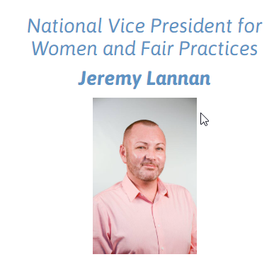
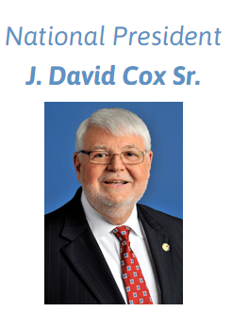
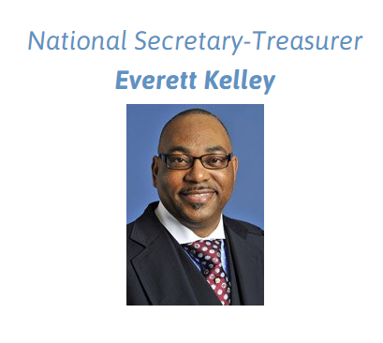
LEADERSHIP ROLE | DESCRIPTION OF DUTIES
Executive Board | Provide leadership and consensus on goals Provide annual budget (reviewed and approved by membership), act for the membership on urgent matters
President | Conducting all Local business, exercise general supervision over the affairs of their Locals Set specific short term and long term goals (Strategic Planning), Approve budget, communicating with fellow officers and members, make worksite visits, supervise all grievances, arbitrations, ULPs
Vice President | Assume all responsibilities of Local in President’s absence (ex: presiding over meetings) Chairman of budget committee & assist sec-treasurer in preparing budget
Secretary | Formal communication link btwn members and President Take minutes at meetings, transcribe notes, assist in setting agenda
Treasurer | Protect Local’s assets, prepare budget, maintain financial records Report finances, handle bonding coverage, arrange audits
Sergeant of Arms | Meet and greet members at Local meetings, welcome and introduce new guest Assist presiding officer in maintaining order
Stewards | Informing workers of rights under the collective bargaining agreement (CBA); monitoring and enforcing the provisions of the CBA; and ensuring employer compliance with federal, state and local laws. Represent and defend in investigatory interviews (Weingarten Rights), that are reasonably expected to result in disciplinary action, and through the grievance procedure.
Committees | Key to an activist Local, getting the programmatic work done( Ex: election, audit, organizing, legislative, health and safety, etc.)
AFGE NATIONAL ORGANIZATIONAL STRUCTURE
NATIONAL
REGIONAL
National
President
DISTRICT
National Vice President
AGENCY/
COMPONENT
Operations Departments
National Secretary Treasurer
National Representatives
WFP District Coordinators
Finance and Information Services Departments
COUNCILS
Council President
National Vice President for Women and Fair Practices
LOCALS
Local President
Local Executive Board
Council Executive Board
Stewards
Women’s and Fair Practices Departments
MEMBERS
Notes:
FYI***(THIS SLIDE HAS ANIMATIONS)***
SAY: If we were to look at the structure of AFGE broadly here is what we have. AFGE is divided into National, Regional, Local and Council entities.
CLICK and SAY: This is the Local level. AFGE has more than 1100 chartered local unions in the US and its territories and Europe. Each local has an Executive Board. The duties of the Executive Board members can be found in the AFGE Constitution and /or Local’s Constitution and Bylaws, but here are a few common roles that one can find at a Local
(ANIMATION HERE) CLICK for pop up of Local Roles and Read Slide Pop Up
CLICK and SAY: So next up is the regional level. AFGE organizes in regions covered by Districts. AFGE has 12 total districts, each one led by one of the national vice presidents. If you know your District and VP please type it in the chat box. Your District is the first resource you all have as Stewards for assistance. Within your district are National Reps and WFP coordinators.
CLICK and SAY: Next is the National level, and the national office is housed in Washington DC. This is where the National President is, as well as these other departments. The NST Office has training available for fiduciary responsibilities, usually bestowed upon members of Local leadership. Also within the National Office is the General Counsel Office where assistance can be requested on any matter affecting employment as a Federal employee. Attorneys from the GCO office are located at various locations throughout the country as well.
(ANIMATION HERE) CLICK for pop up of Pictures of National Officers and Read each one as it pops up
CLICK and SAY: If you look over to your right you see Councils. AFGE has over 121 charted councils and 30 of these are bargaining councils. Bargaining Councils typically negotiate agency wide contracts. The Council level consist of council president and the council e-board. There are resources available from Councils as well, depending on how big the council is, such a training.

Slide 18
AFGE GOVERNING STRUCTURE
What’s the Deal with Dues?
NATIONAL CONVENTION
Members decide dues structure of their Local—should be enough to pay the per capita tax ($21.96) and fund the operating costs of the Local
Recommended: 2x the national per capita tax
Your LOCAL uses dues to: Represent members daily, Grievance/Arbitration, NEO, Trainings, Communications, Special benefit plans for members
The DISTRICT uses dues for: Data processing and administration, Representation, Training, Leg/Political action, Membership/Organizing
The NATIONAL uses dues for: Legal defense/advocacy, Public policy research, WFP work, all of the above.
EXECUTIVE BOARD
National President
National Secretary Treasurer
National Vice President for Women and Fair Practices
AFGE
Constitution
National Vice Presidents
LOCALS
Local President
Local
Constitution
Local Executive Board
Stewards
MEMBERS
Notes:
FYI***(THIS SLIDE HAS ANIMATIONS)***
SAY: Here is where we can really see the democratic structure show up in this union….members vote on the officers, as well as vote on changes to the CBA and overall budget. This happens at the National Convention. That is why it is here at the top, because it is the highest governing body of this union. ASK: Has anyone here attended a National Convention?
SAY: The National Convention occurs every three years.
SAY: Underneath the National Convention, there is The National Executive Council (NEC). The NEC is comprised of 15 members, the National President, the National Secretary Treasurer, the National Vice President of Women’s and Fair Practices, and the twelve National Vice Presidents. Between Conventions, the NEC is the policy making and governing body of this union.
Over to the right of the screen, in the yellow diamond is the National Constitution, which is amended at the Convention and is an overall important part of our union structure because the Constitution sets forth the rules by which the union conducts its business.
Then there is the Local entity, which we have already discussed but again, the governance of this union is only as string as the Locals. The true strength of this union is rooted in our Locals where our members are housed.
(ANIMATION HERE) CLICK for pop up of “What’s the Deal with Dues?” and SAY: We can not talk about structure and governance without mentioning dues. It’s the dues of this union that makes this union. Here are some quick facts about dues. DO: Read Slide

Slide 19
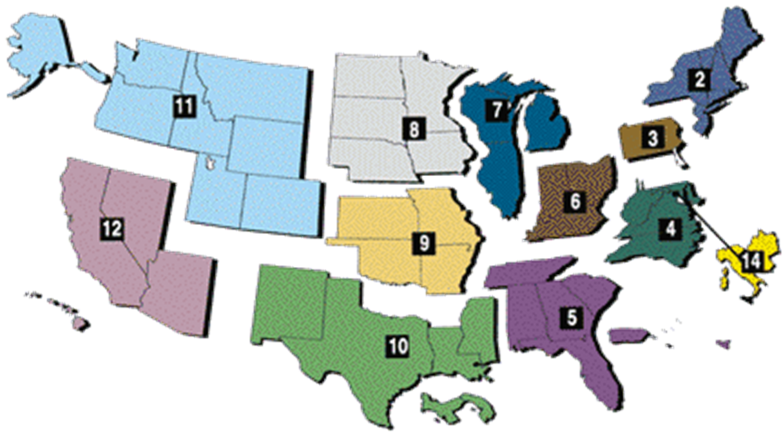
Notes:
BREAKDOWN OF AFGE DISTRICTS
SAY:
Here are the 12 districts that comprise AFGE. This is how it is broken out geographically.
Again, there are 12 National Vice Presidents who oversee these districts.
The NVPs are charged with supervising and directing National Representatives (NRs) assigned to their District; assisting Locals in negotiating and implementing contracts; and handling grievances and appeals at the district level up to and including the regional level (in the 14th District, the NVP deals directly with DC government department heads).
District staffing levels are based on membership numbers within the District. For every 2000 union members, the District hires 1 National Representative. Delegates representing the Locals within each District elect a NVP every three years at a District caucus.
In addition to electing a NVP at each District triennial caucus, a District elects a Fair Practices Affirmative Action Coordinator and a National Women’s Advisory Committee member, which is in total three elected staffers within each district. The Fair Practice Coordinator and the Women's Coordinator assist in implementing District and National Human, Women, and Civil Rights programs at the Local and Council levels. They lobby local legislators on related issues, and partner with AFLCIO constituency groups to build coalitions.
National organizers, Legislative political organizers and national representatives are not elected, but are full time staffers who support departmental functions.
National Organizers work out of headquarters in DC and are dispersed out in the field. They direct and support organizing campaigns under the supervision of the Director of Membership and Organizing.
Legislative Political Organizers direct and support grassroots political action efforts throughout the union
National Representatives are dispersed throughout the districts and under the supervision of the National Vice Presidents. They are assigned to specific Locals by the NVP and are responsible for assisting Local with meeting goals of the union.

Slide 20
AFGE Councils
AFGE DEFCON
AFGE Federal Fire Fighter Steering Committee
AFGE Federal Law Enforcement Council
AFGE TSA Council 100
Air Force Materiel Command Locals (C-214)
Council 252
Council of National Archives and Records Administration (NARA) Locals (C-260)
DFAS Council of DFAS Locals (C-171)
Defense Contract Management Agency (C-170)
EPA Locals (C-238)
ICE Council 118
Midwest Council of Food Inspection Locals (C-202)
National Border Patrol Council
National Council of EEOC Locals 216
National Council of Field Labor Locals (C-73)
National Council of HUD Locals (C-222)
National Council of Prisons Locals (C-33)
National Council of SSA Field Operations Locals (Atlanta Region) (C-220)
National Council of SSA Field Operations Locals (C-220)
National Council of VA Locals (C-53)
National Joint Council of Food Inspection Locals (C-45)
Notes:
BREAKDOWN OF AFGE COUNCILS
SAY:
AFGE has more than 121 chartered councils who have been approved by the union’s NEC. Only locals in good standing may be affiliated with AFGE councils. Of this number, approximately 30 are Bargaining Councils. Bargaining Councils typically represent member locals at the agency level of the labor and management relationship; elect their own officers at their own conventions attended by Locals in the councils; negotiate agency-wide contracts covering council locals; and lobby for their Locals’ issues.

Slide 21
AFL CIO
Largest federation of unions in the United States
AFGE is a member of the AFLCIO, especially at the regional level
AMERICAN FEDERATION OF LABOR
CONGRESS OF INDUSTRIAL ORGANIZATIONS
WWW.AFLCIO.ORG
State Federations, Area Labor Federations, Central Labor Councils
Mobilize around organizing campaigns
Focus on county or city concerns: lobbying, elections, zoning, county/city economic issues
State legislative work; collective local union actions like boycotts, strikes & picketing
Visit AFL website to get connected
Allied Groups
Area Labor Federations
State Federations
Constituency Groups
Non-profit, non-partisan organizations
Under-represented groups: increasing membership, voter registrations, mobilizing bodies
Examples: A. Phillip Randolph Institute, Coalition of Labor Union Women, Pride at Work
Central Labor Councils
Constituency Groups
Affiliate Unions
Notes:
FYI***(THIS SLIDE HAS ANIMATIONS)***
SAY: A big part of our structure that often is not discussed is the AFL-CIO
ASK: What does AFL-CIO stand for? Do: Wait for responses via chat or hands raised
CLICK and SAY: AFGE is a member of the American Federation of Labor and the Congress of Industrial Organizations (AFL- CIO, the largest federation of unions in the United States, made up of 56 national and international unions, together representing more than 12.5 million workers. AFL’s mission is to advance social and economic justice in our nation by enabling working people to have a voice on the job, in government (hence our connection), and in their communities. And that is the area that really serves local leaders and members, because the AFL has many opportunities for all of us to connect on the local level, right where you all are. Let’s take a look at some of these opportunities.
CLICK and READ all the points that come up.

Slide 22
What is a reason for affiliating with the AFL-CIO?
2. What happens at the National Convention?
3. What three offices are elected at the District level?
Notes:
SAY: POP QUIZ TIME! We have been moving through a lot of content, so lets test our knowledge here. Raise your hand or use the chat box to respond.
Possible Answers:
1. What is a reason for affiliating with the AFL-CIO?
A: We share a similar mission, vision and goals; We pay a per capita tax to the AFL-CIO; We join other national labor unions to work under this umbrella union to be more powerful and effective.
2. What happens at the National Convention?
A: Laws and policies are adopted; Constitution is amended; Election of National President, Secretary-Treasure, and National Vice President for Women’s and Fair Practices; Per Capita Dues are established; Final court of review for members who feel they have not been treated fairly at lower levels of the union.
3. What three offices are elected at the District level?
A: National Vice President, Fair Practices Coordinator, Women’s Coordinator

Slide 23
AFGE National Constitution
Notes:
AFGE CONSTITUTION
SAY:
As a leader in AFGE knowing what is in the AFGE Constitution is imperative because it sets forth the rules by which the union conducts its business. Our Constitution is THE framework for how this union operates. It is important to know that the AFGE Constitution is a living document. Any changes or amendments to the constitution are made by democratically elected delegates at the National Convention.
Because the Constitution is so important, we will spend some time familiarizing ourselves with it in more detail. You all should have a copy of the Constitution in the Materials tab. Take a moment to start to open it up.

Slide 24
sets forth the rules by which the union conducts its business
THE framework for how this union operates
Is a living document and changes/ amendments made by democratically elected delegates at the National Convention every 3 years
Some things included:
Membership
Structure and Governance
Duties of Officers
Discipline
Election of Officers
Notes:
AFGE NATIONAL CONSTITUTION (GROUP WORK)
DO: READ SLIDE:
Summary:
The AFGE National Constitution contains the rules and regulations adopted by the AFGE National Convention, which meets triennially.
The AFGE National Constitution is the supreme governing document of the Federation. If a provision of a Council or Local constitution conflicts with the AFGE National Constitution, the conflicting provision may not be enforced.
The AFGE National Constitution incorporates controlling laws, such as in Article XXIV, Section 8(c), regarding the bonding of all labor organizations required by law. The General Counsel’s Office reviews the Constitution and any proposed amendments prior to each National Convention to determine whether any provision or amendment might conflict. In the event of any such conflict, the law must prevail.

Slide 25
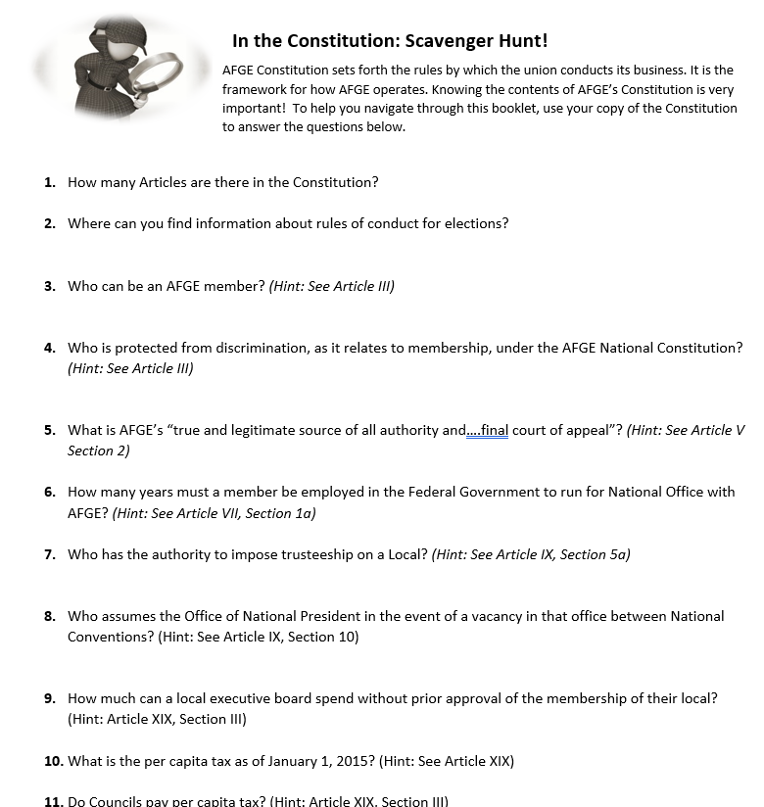
ACTIVITY TIME: In the Constitution
DIRECTIONS:
Go to the materials tab
Find the “In the Constitution” worksheet
Find the AFGE national constitution PDF
Using the Constitution PDF answer the questions
Be prepared to share your answers
Notes:
FYI: ***THIS IS A CLASS ACTIVITY. BEST WAY TO DO THIS IS ASSIGN A QUESTION TO EACH CLASS MEMBER TO SAVE TIME. FOR SMALLER CLASSES ASSIGN MORE THAN ONE QUESTION. Give people a few moments to complete their assigned answer then bring them back to debrief. Answers are on the next two slide. Allow people to answer first then click to show them the correct answers***
SAY: Let’s crack open the Constitution to review some of the contents. Here are the directions.

Slide 26
How many Articles are there in the Constitution?
29 (See Table of Contents)
Where can you find information about rules of conduct for elections?
Appendix A (See Table of Contents)
Who can be an AFGE member? (Hint: See Article III)
SECTION 1(a). All persons of the following classes, without regard to race, creed, color, national origin, sex, age, political affiliation, disability, marital status, sexual orientation, or preferential or nonpreferential civil service status, excepting those over whom jurisdiction has been granted to other national or international unions by the AFL-CIO, and excepting officers of unions not affiliated with the AFL-CIO, shall be eligible for full membership in this Federation.
What is AFGE’s “true and legitimate source of all authority and….final court of appeal”? (Hint: See Article V Section 2)
National Convention
How many years must a member be employed in the Federal Government to run for National Office with AFGE? (Hint: See Article VII, Section 1a)
Three consecutive years in good standing
Notes:
DO: Ask the participant to share their answers then click to show the correct answers to each question.

Slide 27
Who has the power to impose trusteeship?
National President
Who assumes the Office of National President in the event of a vacancy in that office between National Conventions? (Hint: See Article IX, Section 10)
National Secretary Treasurer
How much can a local executive board spend without prior approval of the membership of their local? (Hint: Article XIX, Section III)
$500
What is the per capita tax as of January 1, 2015? (Hint: See Article XIX)
$20.91 Uninsured Locals
$21.96 Insured Locals
Do Councils pay per capita tax? (Hint: Article XXI)
No
How must amendments to the AFGE National Constitution be submitted to be considered by a National Convention? (Hint: See Article XXVIII)
Submitted to NST, 60 days before Convention.
2/3 vote brought to the floor
Notes:
DO: Ask the participant to share their answers then click to show the correct answers to each question.

Slide 28
LEGAL FRAMEWORK for Local Leadership
Notes:
LEGAL FRAMEWORK FOR AFGE
SAY:
As a union that represents Federal and Local Government workers, there are a certain set of Federal laws that directly relate to how we operate and the work that we do. In this next section, we will talk through three of these laws very briefly to start to get a better understanding of those laws.

Slide 29
Relevant Laws
1. Labor Management Reporting and Disclosure Act of 1959 (LMRDA)
2. The Statute | 5 USC Chapter 71
3. Civil Service Reform Act of 1978 (CSRA) | Standard of Conduct for Labor Organizations
Notes:
SAY: We can spend an entire full day training alone on labor law and still wouldn’t scratch the surface. But for this orientation, we will discuss these three.
DO: Read slide.

Slide 30
Enforcement/Accountability
Department of Labor (DOL), Office of Labor-Management Standards (OLMS) manage civil service of Fed Gov
Federal Labor Relations Authority (FLRA) independent Gov agency that governs labor relations between the fed gov and its employees
Merit Systems Protection Board (MSPB) protect against partisan political and other prohibited personnel practices and to ensure adequate protection for federal employees against abuses by agency management.
and for DC Government employees only
Public Employee Relations Board (PERB)
Notes:
SAY: First and foremost here are the agencies responsible for enforcing the LMRDA, CSRA, and DC Labor Relations Law are as follows: the U.S. Department of Labor, Office of Labor Management Standards (DOL, OLMS), Federal Labor Relations Authority (FLRA), and, for DC Government Employees only, the Public Employee Relations Board (PERB). OK, lets continue to discuss, in a little more detail some of the key areas of LMRDA, The Statue and The Standards of Conduct 29 CFR.

Slide 31
LABOR MANAGEMENT RELATIONS DISCLOSURE ACT OF 1959 LMRDA
Notes:
Say: First up, is the LMRDA

Slide 32
Labor Management Reporting and Disclosure Act of 1959 (LMRDA)
Responsibilities of Officers
Bonding. Entities must obtain a bond to protect the union’s assets in case of embezzlement or other internal crimes. Unions with less than $5,000 in total annual receipts are exempt from bonding.
Elections. Covers nominations, ballot secrecy, and other election procedures. The standards apply to union officer elections. They also apply to elections for delegates to conventions at which union officers are elected or dues are voted on.
Reporting. Required to file certain reports with the DOL to document governance and financial integrity. General information on these reporting requirements and on fiscal controls for unions is on the DOL website. The reports are public information and the DOL posts them (as well as a variety of other union information) on its website
Record Keeping. Must maintain for 5 years the records on which their annual LM-2,-3, or -4 reports are based. Examples of these records include:
Credit card statements and itemized receipts for each credit card charge
Copies of bank deposit slips and bank credit and debit memos
Vouchers for union expenditures
Internal union financial reports and statements
Minutes of all membership and executive board meetings
Fixed assets inventory
Election ballots and materials must be kept for 1 year.
DOL advice on recordkeeping requirements is on the DOL website
Federal law requires labor unions to operate with internal democracy and fiscal integrity.
requires unions to meet strong standards of responsibility and ethical conduct, and it protects members against abuse by union officials. The main focus of the LMRDA is unions in the private sector
Established in 1959
What was happening during this time in history?
Established to regulate labor unions’ internal affairs, and their relationships with employers/the agencies
Established the rules that govern the behavior of unions: guarantee certain rights to union members, and impose certain responsibilities on union officers
OLMS enforces many of the LMRDA provisions. Some of the provisions in the LMRDA can only be enforced by union members through private suit in court.
Notes:
FYI***(THIS SLIDE HAS ANIMATIONS)***
Federal law…. (read from slide)
Established in 1959. ASK: What was happening in 1959 that might have influenced the creation of labor laws? (Possible answers:
Established to regulate…(read from slide)
Established the rules…(read from slide)
(Animation HERE) CLICK for POP UP and briefly skim over
CLICK and say: OLMS….(read from slide)

Slide 33
Labor Management Reporting and Disclosure Act of 1959 (LMRDA)
Union Member Rights
Bill of Rights - Union members have:
equal rights to participate in union activities
freedom of speech and assembly
voice in setting rates of dues, fees, and assessments
protection of the right to sue
safeguards against improper discipline
Copies of Collective Bargaining Agreements - Union members and nonunion employees have the right to receive or inspect copies of collective bargaining agreements.
Reports - Unions are required to file an initial information report (Form LM-1), copies of constitutions and bylaws, and an annual financial report (Form LM-2/3/4) with OLMS. Unions must make the reports available to members and permit members to examine supporting records for just cause. The reports are public information.
Protects the rights of union members and ensures freedom and democracy by ensuring members and officers voices are heard, and certain protections are in place
Bill of Rights in Title I
Provide for the reporting and disclosure of certain financial transactions and administrative practices of labor organizations and employers
Prevent abuses in the administration of trusteeships by labor organizations
Provide standards with respect to the election of officers of labor organizations, and for other purposes.
Notes:
FYI***(THIS SLIDE HAS ANIMATIONS)***
SAY:
Protect the rights….(read slide)
Bill of Rights
(Animation HERE) CLICK and Read from the Pop Up
CLICK and Read: Provide for the….
CLICK and Read: Prevent abuses…
CLICK and Read: Provide standards…

Slide 34
Labor Management Reporting and Disclosure Act of 1959 (LMRDA)
Officer Elections - Union members have the right to
nominate candidates for office
run for office
cast a secret ballot
protest the conduct of an election
Officer Elections - Unions must:
hold elections of officers of local unions by secret ballot at least every three years
conduct regular elections in accordance with their constitution and bylaws and preserve all records for one year
mail a notice of election to every member at least 15 days prior to the election
comply with a candidate's request to distribute campaign material
not use union funds or resources to promote any candidate (nor may employer funds or resources be used)
permit candidates to have election observers
allow candidates to inspect the union's membership list once within 30 days prior to the election
Restrictions on Holding Office - A person convicted of certain crimes may not serve as a union officer, employee, or other representative of a union for up to 13 years
Title I: Bill of Rights (just covered in previous slide)
Title II: Financial Reporting Requirements
guarantees the disclosure to union members of information regarding the financial condition of the unions and its officials
Title III: Trusteeships-controls on the use of trusteeships/prevents abuse (will go more into later)
Title IV: Elections
Title V: Safeguards
declares that union officers occupy positions of trust; requires them to hold and use money and property of the union solely for the benefit of the members
Title VI: Misc: grants the Secretary of Labor express power to investigate, inspect records, and to question persons in order to determine whether any provision of the LMRDA has been violated
Notes:
FYI***(THIS SLIDE HAS ANIMATIONS)***
CLICK and Read each point that pops up on this slide.

Slide 35
CIVIL SERVICE REFORM ACT OF 1978 Code of Federal Regulations| Standards of Conduct Regulations
Notes:
SAY: Civil Service Reform Act of 1978

Slide 36
CSRA, Civil Service Reform Act, 1978
Promote democracy and financial integrity in private-sector labor organizations (Federal Government Employees)
Applies to labor organizations which represents employees in most agencies of the executive branch of the Federal Government
Established in response to the Watergate Scandal
Standard of Conduct for Labor Organizations| Section 7120 of Title VII of the CSRA
The Department of Labor's regulations that implement the standards of conduct provisions are found in the Code of Federal Regulations at 29 CFR Parts 457-459
The Act abolished the U.S. Civil Service Commission and distributed its functions primarily among three new agencies: the Office of Personnel Management (OPM), the Merit Systems Protection Board (MSPB), and the Federal Labor Relations Authority (FLRA)
Notes:
SAY: Overall the Standards of Conduct addresses these things DO: (Read slide).

Slide 37
29 CFR IV, Subchapter B, Parts 457-459 (Standards of Conduct)
Designed to implement the standards of conduct for labor organizations in the Federal sector set forth in title VII of the Civil Service Reform Act of 1978 …
Provides procedures and basic principles for Director of Labor to utilize in enforcing the standards of conduct required of labor organizations composed of Federal government employees that are covered by the Statute, LMRDA and CSRA
458.30 Removal of elected officers
When an elected officer of a local labor organization is charged with serious misconduct and the constitution and bylaws of such organization do not provide an adequate procedure meeting the standards of § 417.2(b) of this chapter for removal of such officer, the labor organization shall follow a procedure which meets those standards.
§458.37 Prohibition of certain discipline.
No labor organization or any officer, agent, shop steward, or other representative or any employee thereof shall fine, suspend, expel, or otherwise discipline any of its members for exercising any right to which he is entitled under the provisions of the CSRA or FSA or this subchapter.
Union Member Rights
Reporting Requirements
Union Officer Elections
Trusteeship
Bonding
Removal of Officers/Discipline
Prohibitions against certain discipline
Compliance/Enforcement
Procedures regarding the Member’s Bill of Rights
Hearing Procedures
Complaint Procedures
(5) If such accused officer(s) is found guilty, he may be removed by a procedure which includes:
(i) A secret ballot vote of the members at an appropriately called meeting, or
(ii) A vote of a trial committee or other duly authorized body, subject to appeal and review by the members voting by a secret ballot at an appropriately called meeting.
(6) Within a reasonable time after the charges of serious misconduct are filed with the labor organization final disposition (including appellate procedures) is made of the charges.
Notes:
FYI***(THIS SLIDE HAS ANIMATIONS)***
DO: Read the points that are on the slide.
CLICK and SAY: Here are some of the things that are covered in the Standards of Conduct. DO: Read points
(Animation HERE) CLICK and SAY: So, what does it say regarding Removal of Officers/Discipline? Lets take a quick look. Do: Read over the content in the PopUp
(Animation HERE) CLICK and SAY: Adequate Procedure, let’s look at what that means. Do: Read over the content in the PopUp
(Animation HERE) CLICK and SAY: Another key area to highlight here is Prohibitions against Certain Discipline. DO: Read Slide

Slide 38
5 USC chapter 71| THE STATUTE
Notes:
SAY: 5 USC Chapter 71/The Statute

Slide 39
5 USC Chapter 71 (The Statute)
The Civil Service Reform Act of 1978 led to the creation of Title 5 U.S. Code Chapter 71.
Agencies and Unions commonly refer to it as “the Statute” because it defines the legal framework for federal labor relations.
Notes:
SAY: The Civil Service Reform Act of 1970 led to the creation of Title 5 U.S. Code Chapter 71. Agencies and Unions commonly refer to it as “the Statute” as it defines the legal framework for federal labor relations.

Slide 40
5 USC Chapter 71 (The Statute)
Allows certain federal employees to organize, bargain collectively, and to participate through labor organizations of their choice in decisions affecting their working lives
Defines and lists the rights of employees, labor organizations, and agencies to reflect the public-interest demand for the highest standards of employee performance and the efficient accomplishment of government operations.
Union representation
Information requests
Collective bargaining
Management Rights
Standards for labor organizations
Formal Discussions
Unfair Labor Practices (ULPs)
Notes:
DO: Read Slide

Slide 41
Agencies| Enforcement/Accountability
LMRDA and 29 CFR is regulated by the
Department of Labor (DOL)
Office of Labor-Management Standards (OLMS)
5 USC Chapter 71 is regulated by the
Federal Labor Relations Authority (FLRA) or “the Authority”
Notes:
SAY The agencies responsible for enforcing the LMRDA, CSRA, and DC Labor Relations Law are as follows: the U.S. Department of Labor, Office of Labor Management Standards (DOL, OLMS), Federal Labor Relations Authority (FLRA), and, for DC Government Employees only, the Public Employee Relations Board (PERB).
We want to discuss, in more details, The Statue and The Standards of Conduct 29 C.F.R. §§ 457-459. The Bill of Rights of members or labor organizations, C.F.R §458.2,. These are two very important regulations for union officials.

Slide 42
Lunch break until 1:00pm EDT
Notes:
DO: Use this slide whenever you give the class a lunch break. Keep it up as they break.

Slide 43
What three laws were discussed in terms of Local Leaders responsibilities?
2. Why was LMRDA created?
3. What agencies regulate these laws?
Notes:
SAY: POP QUIZ TIME! We have been moving through a lot of content, so this is a good place to test our knowledge here. Raise your hand or use the chat box to respond.
Possible Answers:
1. What three laws were discussed in terms of Local Leaders responsibilities?
A: LMRDA, CSRA, The Statute
2. Why was LMRDA created?
A: to require the disclosure of financial transactions and administrative practices of unions, employers, and labor consultants, as well as providing standards for election of union officials, trusteeships, and the fiduciary duties of union officers; grants certain rights to union members and protects their interests by promoting democratic procedures within labor organizations
3. What agencies regulate these laws?
A: LMRDA and 29 CFR is regulated by the Department of Labor (DOL) and Office of Labor-Management Standards (OLMS); 5 USC Chapter 71 is regulated by the Federal Labor Relations Authority (FLRA) or “the Authority”; OTHER AGENCIES THAT REGULATE LABOR RELATIONS LAWS: Department of Labor (DOL), Office of Labor-Management Standards (OLMS) manage civil service of Fed Gov; Federal Labor Relations Authority (FLRA) independent Gov agency that governs labor relations between the fed gov and its employees; Merit Systems Protection Board (MSPB) protect against partisan political and other prohibited personnel practices and to ensure adequate protection for federal employees against abuses by agency management.

Slide 44
HARD CASES
Notes:
HARD CASE ACTIVITY
SAY: Alright, so let’s put our knowledge, experience and most importantly our critical thinking skills to the test. In this next section, called “Hard Cases” you will be given a scenario, which I will read aloud, and I will give you a moment to think about it. You will decide the best possible option or action or decision for each scenario. Keep in mind the laws, the constitution, leadership skills that may come into play in each of these scenarios.

Slide 45
Chuck attends all local membership meetings, but he is loud and critical of the leadership at virtually every meeting. Because of his antics and verbal abuse of officers and other members, attendance of other members has declined, and it is difficult to conduct business at the meetings. The Executive Board is meeting to consider what to do about Chuck. What options does it have? Can it bar him from meetings, order him to leave if he criticizes, file disciplinary charges against him, or suspend him from membership?
Take a moment. Think about the best action to take. Important: What is prohibited in terms of the law?
Wait for Instructor to debrief
Notes:
DO: READ THE SCENARIO ALOUD. GIVE EVERYONE SOME TIME TO THINK AND DECIDE ON THEIR RESPONSE THEN SOLICIT RESPONSES VIA CHAT OR RAISED HANDS.
Possible actions: Talk to Chuck 1:1; Ask someone else who is diplomatic to take Chuck outside the meeting to talk; Ask Chuck to refrain from his disruptions; Use Sergeant of Arms, according to Roberts Rules of Order;
Sources:
LMRDA §101(a)(2); 29 CFR §458.2(a), §458.37; libel cases; call security.

Slide 46
LMRDA 101(a)(2)
Title I Bill of Rights of Members
Union Member Rights, (a)(1) |Every member has the right to nominate, vote in elections, attend meetings and vote on business.
Freedom of Speech (a)(2) |Every member has a right to freedom of speech, as long as it does not interfere with legal or contractual duties.
Dues, (a)(3) |Increases only accomplished by reasonable notice (standard being 30 days), majority vote, secret ballot (can be mailed)
Members Right to Sue, (a)(4) |Members can sue if rights are violated, but must go through an internal process.
Disciplinary Action, (a)(5) |Safeguards against improper disciplinary actions
Notes:
SAY: Let’s remember the rights that all members have under the LMRDA in Title I: the Bill of Rights of Members. The second one listed is Freedom of Speech which in summary (read point two from the slide). The extended version talks specifically about the member having the right to verbalize any conflicting perspectives, ideas etc at any meeting. So, all in all, Chuck does have a right to be expressive of his views at these meetings. The caveat here is the last part that says as long as it does not interfere with legal or contractual duties. Depending what’s on the agenda, his antics may very well fall under that category, but it may be something that is hard to prove under review.
SAY: So, if your Eboard does decide to move forward with discipline, there is something called filing an Article 23. (CLICK for more information on the next slide).

Slide 47
In the Constitution! Scavenger Hunt
Article XXIII: Offenses, Trials, Penalties, Appeals
“Article 23”
Advocating, encouraging, or attempting to bring about a secession from the Federation …
(b) Working in the interest of or becoming a member of the Communist Party…
(c) Violation of any provision of this Constitution/bylaws of the local
(d) Making known the business of any affiliate of the Federation to management officials of any agency
(e) Engaging in conduct unbecoming a union member;
(f) Gross neglect of duty or conduct constituting misfeasance or malfeasance in office
(g) Incompetence, negligence, or insubordination in the performance of official duties
(h) Fraud, embezzlement, mismanagement, or appropriating to one's own use any money, property
Refusing, failing, or neglecting to deliver …a full and accurate account of all monies, properties, books, and records for examination and audit; and/or
(j) Assisting, counseling, or aiding any member or officer of the Federation or any of its affiliates to commit any of the offenses herein set forth.
Section 1: The Local is expected to handle its own discipline if it can
Section 2: List of offenses for which charges may be brought
Section 3: Investigating and preferring charges
Section 4: Local trial committee
Section 5: The accused has a right to representation
Section 6: If the accused fails to show up, the trial must go on without him/her
Section 7: For local trial committees, the trial committee presents its finding to the membership
Section 8: The decision goes into effect immediately, pending appeal
Section 9: Appeals are made to NEC by the accused only
Notes:
SAY:
Article 23 refers to a section in the Constitution that discusses Discipline, entitled: Offenses, Trials, Penalties, Appeals. In section 1: The Local in which the member is part of is responsible for handling discipline. If the trial involves a Council Officer, then the Council is expected to handle the discipline.
SAY: This Article is divided into sections that discusses the following. DO: (Read section titles from the slide).
(Animation Here) CLICK and SAY: The section that best relates to Chuck is section 2, Read content from PopUp

Slide 48
Judy wants to join your Local. Unfortunately, in the past she has loudly criticized AFGE and has urged other employees to seek another union. Now she brags that she will get into the Local in order to “destroy it from the inside.” She has signed and submitted a SF-1187, dues allotment form, to become a member. What can your Local do?
Take a moment. Think about the best action to take. Important: What is prohibited in terms of the law?
Wait for Instructor to debrief
Notes:
DO: READ THE SCENARIO ALOUD. GIVE EVERYONE SOME TIME TO THINK AND DECIDE ON THEIR RESPONSE THEN SOLICIT RESPONSES VIA CHAT OR RAISED HANDS.
Possible actions: Talk to Judy 1:1 about her issues; Threaten to file an Article 23; Accept her 1187 and wait/hope for the best, possibly organize a plan to flip her into being a champion for the union considering she seems to have influence.
Sources:
5 U.S.C. §7116(c);
FLRA ALJ 4-CO-10021 (1992); charges and trial under Article XXIII

Slide 49
The Statute gives employees the right:
The Statute also states:
For the purpose of this chapter it shall be an unfair labor practice for an exclusive representative to deny membership to any employee in the appropriate unit represented by such exclusive representative except for failure--
To form, join, or assist any labor organization; or to refrain, freely and without fear of penalty or reprisal.
To act for a labor organization in the capacity of a representative and to present the views of the labor organization
To engage in collective bargaining
Citation: § 7116c
Citation: § 7102
Notes:
SAY: The law that you should remember in the Judy scenario is 5 USC Chapter 71. The Statute gives federal employees the right to form, join, or assist any labor organization; or to refrain, freely and without fear of penalty or reprisal. To act for a labor organization in the capacity of a representative and to present the views of the labor organization and to engage in collective bargaining. So Judy does have a right to join the union according to federal law.
CLICK and SAY: You want to also keep in mind another section of the statute that expresses that it can be considered an unfair labor practice for the union to deny her membership. This is an example of why it is indeed important to know the law. If you jump to a decision solely based on emotional reaction, you could be in some trouble.

Slide 50
Your Local Vice President, and long-time family friend, Jim, has just come to your office and closed the door. You, Local 7303’s President, ask him “what’s up?” and Jim confesses that he was convicted of a felony – obstruction of justice – seven years ago, but never served time in jail because he was sentenced to two years on parole, which ended five years ago. Is this a problem? If so, what should you do?
Take a moment. Think about the best action to take. Important: What is prohibited in terms of the law?
Wait for Instructor to debrief
Notes:
DO: READ THE SCENARIO ALOUD. GIVE EVERYONE SOME TIME TO THINK AND DECIDE ON THEIR RESPONSE THEN SOLICIT RESPONSES VIA CHAT OR RAISED HANDS.
Possible actions: Ask Jim to gracefully step down to prevent any confusion; Do a bit more research (question is: he holds a federal government job—how did he pass background checks etc?); If Jim lied about this previously this is definitely a reason he should be sat down;
Sources:
29 C.F.R. §458.36; various state criminal statutes

Slide 51
29 CFR, Subchapter B| Standards of Code Regulations
458.36 Prohibitions against certain persons holding office or employment.
The prohibitions against holding office or employment in a labor organization contained in section 504(a) of the LMRDA are incorporated into this subpart by reference and made a part hereof.
The prohibitions shall also be applicable to any person who has been convicted of, or who has served any part of a prison term resulting from his conviction of, violating 18 U.S.C. 1001 by making a false statement in any report required to be filed pursuant to this subpart, or who has been determined by the Director after an appropriate proceeding pursuant to §§ 458.66 through 458.92 to have willfully violated § 458.27:
Provided, however, That the Director or such other person as he may designate may exempt a person from the prohibition against holding office or employment or may reduce the period of the prohibition where he determines that it would not be contrary to the purposes of the CSRA or the FSA and this section to permit a person barred from holding office or employment to hold such office or employment.
Notes:
SAY: In this scenario with Jim, there is a section in 29 CFR Subchapter B that spells out clearly reasons why certain people can NOT hold office. As underlined here, it does say “convicted of” which is true of Jim though he didn’t serve any time in prison. This could be a tough call, but you will need to remember you do have to make decisions based on the law and what is best for the Local.

Slide 52
FIDUCIARY RESPONSIBILTIES
Notes:
SAY:
Now we are going to talk about some of your fiduciary responsibilities. I do want to clarify that while you are getting a portion of the material from the Financial Officer’s training, what will be presented to you today is not, I repeat, is not a substitute for the Financial Officer’s training.

Slide 53
Where is this Information?
AFGE Constitution
Labor Management Reporting and Disclosure Act
Civil Service Reform Act
Local Bylaws
Union and Local Operating Practices
Notes:
SAY: There are several places where fiduciary responsibilities are outlined, and as an AFGE leader, you should know all of them, and what they say. As we have been saying throughout the training, we do not have the time to go through every single thing, but we will spend time reviewing some of the highlights.
So this is where you can find information on Fiduciary responsibilities (click the slide to show the list).

Slide 54
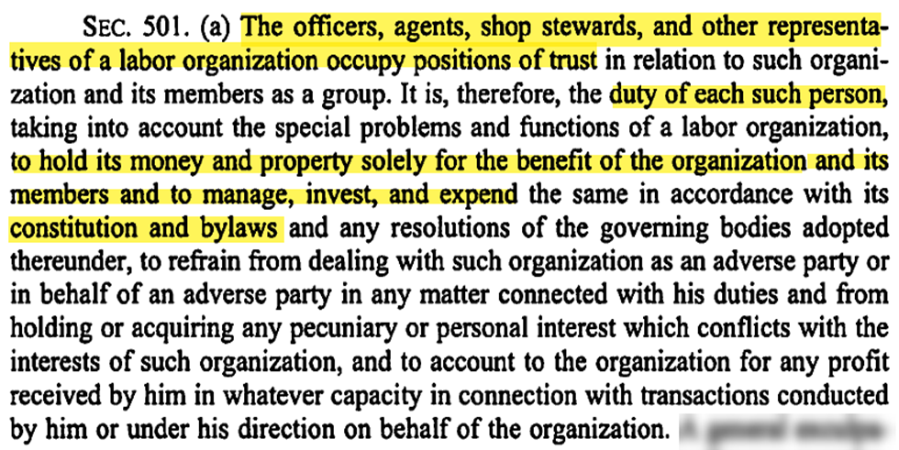
Who Are The Financial Officers ?
President
Vice-President
Treasurer
Executive Board
Or individuals that make financial decisions or reviews for the Local
Audit Committee
Budget Committee
Notes:
SAY: So who is has responsibility over finances? DO: Wait for responses, then click to show the lost
SAY: These people! Yes, all of these individuals in some capacity is responsible for the Local’s finances. So essentially all Officers should know the ins and outs of Fiduciary responsibilities.
I repeat, Every Local president and officer stands in a fiduciary position with respect to the union and its members and that is spelled out in the LMRDA Section 501 under Title V: Safeguards for Labor Organizations, Fiduciary Responsibility of union officers

Slide 55
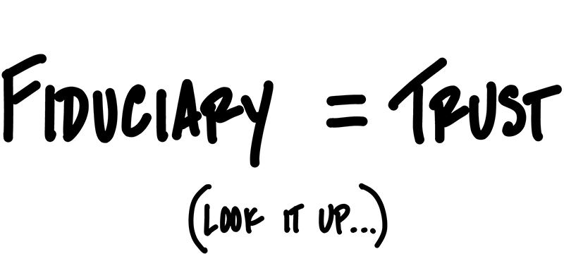
Fiduciary Responsibilities
Local Officers manage and handle funds which belong to the Local and its members; holding positions of trust known as “fiduciary positions”
Hold the Union’s money and property solely for the benefit of their Union and its members.
Manage, invest, and disburse funds and property only as authorized by the Union’s Constitution and By-laws or by proper resolution of its membership
Refrain from financial or personal interests which conflict with those of their Union; and account to their Union for any profits received from transacting Union business.
Fiduciary Duties are imposed on Union Officers by law.
Notes:
CLICK and Read content from the slide.

Slide 56
General Responsibilities
Safeguard the property of the Local and its members
Collect and disburse Local funds
Accurately record all financial transactions
Report to Federal and State Government Agencies
Notes:
SAY: Overall, as a Financial Officer, you are entrusted by the membership to faithfully perform vital duties such as: safeguarding the property of the Local and its Members, collecting and disbursing Local funds, accurately recording all financial transactions, and reporting to Federal and State Government Agencies

Slide 57
Local Credit Cards
How to avoid problems when using Credit Cards :
Credit Cards should be in the name of the Individual Local Officer
Monthly dollar amount limits should be placed on Credit Cards
No ATM or Debit capability should be allowed
Credit Cards are to be used for Local business only. No personal charges by an officer.
A Credit Card Statement should not be considered authorization for payment—You must provide receipts, hotel statements, vouchers, etc.
Use of a Credit Card should be defined in the Local’s Bylaws.
Notes:
SAY: While we are on the topic of managing the Local’s money properly, let address a topic of interest: CREDIT CARDS. A local cannot effectively conduct financial business without the use of a credit card, but there are some inherent problems with credit card usage. To avoid such problems, credit cards should be in the name of the individual local officer; monthly dollar amount limits should be placed on credit cards; no ATM or debit capability should be allowed; credit cards should be used for Local business only (no personal charges by an officer); a credit card statement should not be considered authorization for payment (you must provide receipts, hotel statements, vouchers, etc.); and use of a credit card should be defined in the Local’s Bylaws.

Slide 58
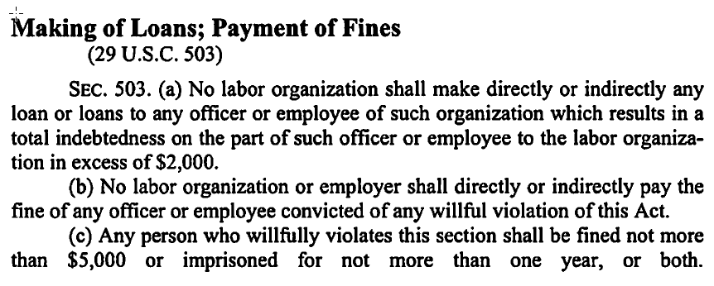
LOANS
AFGE’s position -- Just say no!
If you choose to make loans:
They must be approved by the membership, Board cannot approve loans!
It cannot exceed more than $2,000 per individual
There should be a very clear standard criteria that the Local has adopted
All outstanding advances in excess of $2,000 are considered a loan by DOL
Notes:
SAY: Ok– secondly in regards to properly managing the Local’s funds, lets talk LOANS! The ultimate advice here is to JUST SAY NO! AFGE does not recommend making loans to members because recover of defaulted loans are costly and difficult. However, if a local decides to make a loan, you should follow the guidelines written.
They must be approved by the membership;
The executive board cannot approve loans;
and a loan cannot be more than $2,000 per individual.
SAY: For any loan, there should be a very clear standard criteria that the Local has adopted. Remember what the Local does for one member, you must do for all members and all outstanding advances in excess of $2,000 are considered a loan by the DOL.
SAY: Remember, what the Local does for one member, you must do for all members.

Slide 59
Guilty of a Violation?
Subject to civil lawsuits in federal or state court for money damages or other appropriate relief.
Criminal penalties for embezzling or stealing Local property
fines up to $10,000.00
imprisonment for up to five years
both
Notes:
SAY: Fiduciary responsibilities are federally regulated! So there are real and intense fines and penalties if they are violated. Consequences could include an officer being personally responsible for losses….
Union officials who violate these federally created fiduciary duties are subject to civil lawsuits in federal or state court for money damages or other appropriate relief. In addition, there are criminal penalties for embezzling or stealing Local property – fines up to $10,000.00, imprisonment for up to five years, or both.

Slide 60
Annual Local Audit Checks and Balances
Notes:
SAY:As with any organizations there is a system for checks and balances in regards to finances at AFGE, and that comes in the form of an annual local audit.
Each Local is required to conduct an audit at least once a year and make a certification using audit Certification Form 41 to the National Secretary-Treasurer showing that n audit has bee completed. It is mandatory that you conduct an audit at the close of each year end, when there is a chance in financial officers, or when there is a suspicion of any wrong doing.
Because this is actually so important to the fiduciary process, lets review more details about audits.

Slide 61
Conducting A Local Audit
At least once a year--Mandatory
At the close of each Year End
a change in Financial Officers
a suspicion of any wrongdoing
Make a certification using Audit Certification Form 41 to the National Secretary-Treasurer showing that an audit has been completed
Notes:
Read information from the slide.

Slide 62
Conducting Local Audits
Committee Members:
Annual Internal Audit
President should appoint an odd number of members (3 or 5) that do not have signature authority on any accounts
Annual External Audit
May hire outside Accountants or Bookkeepers
Monthly Audits by the Financial Officers
Savings, Checking, Investment, and Credit Card Account statements to insure all items have been reconciled.
Also review checkbook and dues deduction listings
Notes:
SAY: If you haven’t done so already, you should make sure that you identify an audit committee or someone to conduct the audit. If you are having an annual internal audit, the President should appoint an odd number of members (3-5) that do not have signature authority on any accounts to this committee. You may hire outside accountants or bookkeepers to perform an annual external audit if you so choose. AFGE suggests that the Financial Officers conduct an audit of the Savings, Checking, Investment, and Credit Card account statements on a monthly basis to insure that all items have been reconciled. A review of the checkbook and dues deduction listings is also recommended.

Slide 63
Records Needed to Perform Audit
Checkbook
Savings, checking, and investments account statements, cancelled checks, deposit slips, and credit card statements
Dues deduction listings
Local constitution and by-laws
Minutes of local meetings
LM-2, LM-3, or LM-4 reports for the past 2 years
IRS 990 EZ or 990 for past two (2) years
Annual budget
Prior audit committee reports
Form W4’s for the past two years – payroll
Current financial roster
Inventory of all fixed assets (i.e. computer or office furniture)
Payroll tax returns, forms 940, 941, W-2’s and 1099’s
Notes:
SAY: Here are some things that are required to conduct an audit DO: (Read Slide)

Slide 64
Red Flag Items During an Audit
Checks written to INDIVIDUALS
Advance payment of salary to employees
Unbalanced checkbooks with no deposit records
One signature checks
Pre-signed checks by ONE OFFICER
Checks written out of sequence
Checks written to CASH
Notes:
SAY: Here are some red flags. If these come up during an audit, sound the alarm, or look more into it. DO: (Read Slide)

Slide 65
Bonding
Notes:
SAY: Bonding is required to protect Unions from financial losses; think of it as an insurance policy that insures an organization against financial loss

Slide 66
Bonding Requirements
In order for your bond to be in effect you must
conduct an Annual Audit
submit to AFGE a Form 41 with a copy of your LM Report and the approved Annual Budget.
The Labor-Management Reporting and Disclosure Act (LMRDA) establishes specific bonding requirements
Notes:
SAY: The Labor-Management Reporting and Disclosure Act (LMRDA) establishes specific bonding requirements to protect Unions from financial losses caused by “fraudulent or dishonest acts” by Union Officers or employees. All AFGE Locals are covered under a blanket bond and charged annually for the coverage.
SAY: In order for your bond to be in effect, you must conduct an annual audit and submit to AFGE a Form 41 with a copy of your LM report and the approved annual budget. The Labor-Management Reporting and Disclosure Act (LMRDA) established specific bonding requirements.

Slide 67
LMRDA Bonding Requirements
Required coverage
CA + TR x 10% = amount of coverage required
CA is current assets (cash, investments)
TR is total receipts
10% is the amount of coverage required
AFGE’s recommendation
CA + TR x 100%
Notes:
SAY: A bond, like any insurance policy has a maximum recovery amount. Per the Department of Labor, the bond must be equal to at least 10 percent of the Local’s assets. A quick formula for computing required coverage is current assets (cash, investments) plus total receipts multiplied by 10%. That is the least amount of coverage you should have. AFGE is strongly recommended that your coverage be 100% of your total assets.
All AFGE Locals are covered under a blanket bond and charged annually for the coverage

Slide 68
IS IT TRUE?
IS IT FALSE?
Notes:
SAY: POP QUIZ TIME! We have been moving through a lot of content, so this is a good place to test our knowledge here. Use the poll feature or use the chat box to respond to the following true or false statements.

Slide 69
TRUE or FALSE
A member of the NEC or any duly authorized representative must give you a 72 hour notice if they desire to look at your records.
Notes:
1. A member of the NEC or any duly authorized representative must give you a 72 hour notice if they desire to look at your records. False – all books, records, and financial accounts shall be open to the inspection of the National Executive Council or any duly authorized representative - the Constitution doesn’t say anything about advance noticed.

Slide 70
TRUE or FALSE
It is mandatory for the Local to conduct an audit when there is a change in Financial Officers
Notes:
2. It is mandatory for the Local to conduct an audit when there is a change in Financial Officers? True – Ask participants what other two times must an audit be conducted – at the close of each year end or when there is a suspicion of any wrongdoing.

Slide 71
True or False
There are criminal penalties for embezzling or stealing Local property that can include fines up to $10,000, imprisonment for up to five years, or both.
Notes:
3. There are criminal penalties for embezzling or stealing Local property that can include fines up to $10,000, imprisonment for up to five years, or both. True

Slide 72
True or False
In order for your bond to be in effect, you must conduct an annual audit and submit two documents to AFGE; a Form 41 and a copy of LM report.
Notes:
4. In order for your bond to be in effect, you must conduct an annual audit and submit two documents to AFGE; a Form 41 and a copy of LM report. False – you should submit 3 documents, a Form 41, a copy of your LM report, and the approved annual budget.

Slide 73
True or False
Pre-signed checks by one officer is a red flag item during an audit.
Notes:
5. Pre-signed checks by one officer is a red flag item during an audit. True

Slide 74
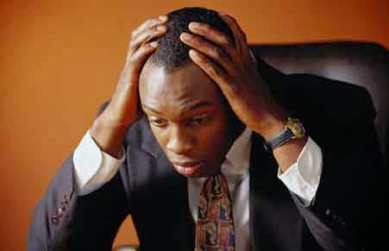
Fiduciary Reporting
Notes:
SAY: FIDUCIARY REPORTING causes a lot of stress for many local leaders. BUT, It does not have to be stressful nor painful. We do not have time allotted to go into the ins and outs of reporting in this short orientation but just remember to keep yourself organized, and understand the process thoroughly. Do not wait until the last minute to get all the information needed to file your reports, these should be kept by the Treasurer throughout the year.
ASK: Does anyone have any tips or best practices that they would like to share?

Slide 75
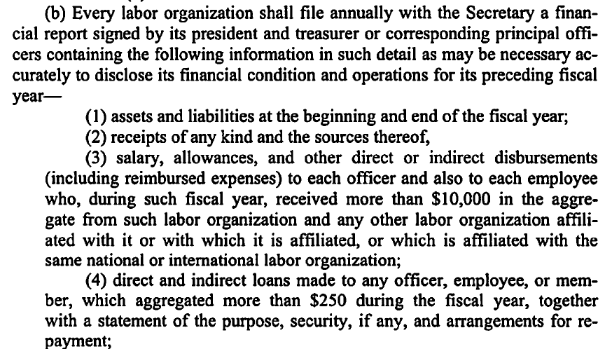
Required by Federal law LMRDA Says….
Notes:
SAY:

Slide 76
Who Do You Report To? (Also where to find more information about requirements)
Internal Revenue Service (IRS)
Department of Labor (DOL)
Your Local Membership and AFGE Headquarters
Notes:
SAY: One of the things I want to highlight is who you have to report to. (Read Slide)

Slide 77
TRUSTEESHIP

Slide 78
Trusteeship
exists whenever a parent union suspends a subordinate union's constitutional or statutory autonomy
the parent assumes control over affairs that the subordinate would normally handle itself
action referred to as an “administratorship,” “stewardship,” or “supervisorship”
Even when the suspension of autonomy is only partial, a trusteeship exists and is subject to the LMRDA.
Notes:
SAY: Under law and DoL regulations (§458.26), AFGE may place affiliates in trusteeship for such purposes as (a) correcting corruption or financial malpractice, (b) assuring the performance of negotiated agreements or other duties of a representative of employees, (c) restoring democratic procedures, or (d) otherwise carrying out the legitimate objects of such labor organization. The two most common reasons for trusteeship are that the officers fight so much amongst themselves that the local can’t function and the failure to pay per capita tax.
.

Slide 79
Trusteeship
Reasons that are NOT VALID:
Section 302 of the LMRDA
A trusteeship imposed because a local was delinquent in paying a per capita tax increase it was challenging in court;
A trusteeship imposed to force a local to affiliate with a district council and to raise dues as a result of the affiliation;
A trusteeship established in bad faith primarily to maintain the status quo in the union and to keep the entrenched leadership in power, even though conditions that had existed in the union for some time would otherwise have been legitimate grounds for imposing a trusteeship;
A trusteeship established in fear that union members would elect officials who are incompetent or corrupt;
A trusteeship imposed for the sole purpose of preventing disaffiliation; and
Notes:
SAY: Under law and DoL regulations (§458.26), AFGE may place affiliates in trusteeship for such purposes as (a) correcting corruption or financial malpractice, (b) assuring the performance of negotiated agreements or other duties of a representative of employees, (c) restoring democratic procedures, or (d) otherwise carrying out the legitimate objects of such labor organization. The two most common reasons for trusteeship are that the officers fight so much amongst themselves that the local can’t function and the failure to pay per capita tax.
.

Slide 80
Trusteeship
Reasons
Section 302 of the LMRDA
Correct corruption or financial malpractice
Assure the performance of negotiated agreements (collective bargaining) or other duties
Restore democratic procedures
Most common
Fighting
Failure to pay
Notes:
SAY: Under law and DoL regulations (§458.26), AFGE may place affiliates in trusteeship for such purposes as (a) correcting corruption or financial malpractice, (b) assuring the performance of negotiated agreements or other duties of a representative of employees, (c) restoring democratic procedures, or (d) otherwise carrying out the legitimate objects of such labor organization. The two most common reasons for trusteeship are that the officers fight so much amongst themselves that the local can’t function and the failure to pay per capita tax.
.

Slide 81
Trusteeship
When imposed
AFGE removes current officers
Considered valid by DoL for 18 months
§ 458.27 and §458.28
Notes:
SAY: When it imposes trusteeship on a local, AFGE removes the current officers, but must allow the local to elect delegates to national elections. Also, AFGE cannot impose trusteeship to seize assets from locals, except for what the local may owe in per capita or other assessments (§ 458.27). DoL will consider a trusteeship valid for 18 months if AFGE follows its Constitution and there was a fair hearing(§ 458.28
SAY: DOL regulations also impose a number of fiduciary obligations (§§458.31, 458.32, 458.33, 458.34, 458.35) upon local union officers, which we will be covering in greater detail in that section. The overarching principle to take home is that the local’s money belongs to the members and should be spent for their benefit as a union.
When you get a chance, read 29 U.S.C. § 501(a). This statute means, among other things, that you should have no conflicts of interest with the local, such as business dealings, nor should your family. While legally the local can lend money to members or officers, it shouldn’t. If it does, any loans should not exceed $2,000 and must be treated like a loan, meaning that it should be pursuant to an agreement that sets up regular payments and interest.
Department of Labor regulations (§458.3 and § 403) require that your local file LM reports, which we will discuss more during the section on Fiduciary Responsibilities. One small point to remember is that you are required to file your constitution and bylaws with it. As a result, your bylaws are a matter of public record.
On a related note, people convicted of certain crimes may not hold union office for thirteen years after conviction or the end of his or her imprisonment, whichever is more recent. The statute (29 U.S.C. § 504) lists a number of offenses, including bribery, extortion, murder, rape, and violation of narcotics law, but some of the offenses are not as clear. It can get confusing with regard to whether an offense is covered or when the thirteen years begins to run, so if you have any questions about this, you should contact the General Counsel’s Office

Slide 82
HATCH ACT
Notes:
SAY: Elections are approaching so we wanted to make sure you all have a quick review about the hatch act.

Slide 83
Skills needed for successful legislative and political mobilization
Differentiate between legislative and political activities.
Identify ways to get members more involved in the legislative process.
Determine if a situation is a violation of the Hatch Act
Notes:
READ SLIDE

Slide 84
Legislative vs Political Activities
Legislative = governing
Issues Proposed law
House & Senate bills
Political = elections
Candidates
Political parties
Fundraising
Notes:
READ SLIDE

Slide 85
Hatch Act Guidelines
OK
Issue and legislative activity
Personal actions away from government facility or identification
Non-partisan political activity (not related to any party)
PAC fundraising
Not OK
Candidate and election activity
Government duty time, facility, or identification
Partisan campaigns (party affiliated)
Candidate fundraising
Notes:
READ SLIDE

Slide 86
Hatch Act DO’s and DONT’s
Employees May:
1. Register and vote as they choose;
2. Assist in voter registration drives;
3. Express opinions about all candidates and issues, privately and publicly;
4. Run for election to a non-partisan office;
Notes:
READ SLIDE

Slide 87
Hatch Act DO’s and DONT’s
Employees May:
5. Contribute money to political organizations or attend a political fund raising function;
6. Sign petitions, including nominating petitions;
7. Wear political badges or buttons (except in government buildings or on uniforms);
8. Run for office within party organizations and affiliate groups;
9. Attend political conventions, rallies and meetings as an elected representative of a
partisan organization;
Notes:
READ SLIDE

Slide 88
Hatch Act DO’s and DONT’s
10. Take an active part in political management of campaigns;
11. Solicit contributions to the political action committee of the organization to which employees belong provided that the contributor is not a subordinate employee;
12. Conduct voter registration drives on-site prior to AFGE’s endorsement of a candidate.
Notes:
READ SLIDE

Slide 89
Hatch Act DO’s and DONT’s
Spouses and other members of an employee’s family may engage in all forms of partisan political activities.
Non-federal unions in the private sector are not covered by the Hatch Act.
Notes:
READ SLIDE

Slide 90
Hatch Act DO’s and DONT’s
Employees May Not:
1. Be candidates for public office in partisan politics;
2. Use their official position to influence or coerce colleagues or election results;
3. Wear partisan political buttons or stickers while on duty;
Notes:
READ SLIDE

Slide 91
Hatch Act DO’s and DONT’s
Employees May Not:
4. Collect, solicit, receive, handle, disburse or account for contributions from the general public (NO FUNDRAISING);
5. Wear a government uniform or government insignia while engaged in political activities;
6. Sell tickets to a political fund raising function to the general public;
7. Use government equipment such as email for political activities.
Notes:
READ SLIDE

Slide 92
2 Key Rules to Remember
# 1 - You may pursue legislative activity on official time (if provided by your contract) and on site (if not prohibited by your contract), but you may not perform political or electoral work on site or on official time.
# 2 - You may solicit financial contributions to the AFGE PAC off-site only and you may only ask other AFGE members to give.
Notes:
READ SLIDE

Slide 93
HATCH ACT SCENERIO #1
The US presidential election is underway and the AFGE National E-Board has endorsed a candidate.
Your Local votes to hold a voter registration drive in the Cafeteria every month until the election.
IS THIS A HATCH ACT VIOLATION?
Notes:
DO: LAUNCH POLL (YES OR NO)
ANSWER: YES IT IS A VIOLATION. THIS IS NOT ACCEPTABLE BECAUSE ONCE AFGE HAS ENDORSED A CANDIDATE YOU CAN NOT REGISTER VOTERS AT A FEDERAL WORKSITE. YOU COULD DO AN OFFSITE DRIVE. AS WELL AS NON-PARTISAN COALITION PARTNER WORKING TO REGISTER VOTERS.

Slide 94
An AFGE member has invited a few co-workers in the department out for happy hour event at a local bar. One of the Local Vice Presidents are also invited to attend.
At the happy hour the conversation start to get into politics. The Local Vice President ask the group “ are you all willing to do what you can and volunteer to help elect Sue Mallory for the 3rd District Congressional seat?”
The group exclaimed “YES!” and everyone gave a toast to the candidate.
IS THIS A HATCH ACT VIOLATION?
HATCH ACT SCENERIO #2
Notes:
DO: Launch yes or no poll
ANSWER: YES THIS IS ACCEPTABLE AND NOT A VIOLATION. ANYONE IS FREE TO EXPRESS THEIR OPINION , VOLUNTEER, RALLY, ETC. WHEN YOU ARE OFF DUTY AND NOT IN GOVERNMENT UNIFORM. RESTRICTIONS FOR THIS WILL INCUDE WEARING GOVERNMENT UNIFORM.

Slide 95
Resources

Slide 96
External Resources
www.aflcio.org
Get Connected w/ Internal Resources:
www.afge.org
https://afgelearn.moonami.com/

Slide 98
Questions
&
Answers

